Slide 1


MODULE 4
Overcoming Personal Challenges To Become a Resilient Entrepreneur
www.ingrow.eu
This resource is licensed under CCBY 4.0

Slide 2
TABLE OF CONTENTS
01
Resilience for Migrants
02
Cross-Cultural Communication
03
Building Self-Confidence
04
Embracing a Global Perspective & Utilizing a Global Advantage
05
Mental Wellbeing & Support Resources
2

Slide 3

SECTION
01
Resilience for Migrants

Slide 4

What is resilience?
Resilience is the ability to cope with and recover from setbacks. People who remain calm in the face of disaster have this quality.
A resilient person is someone who has strong coping skills and can manage their available resources, ask for help when needed, and find ways to manage the situation they are facing. In the case of immigrants, we must keep in mind if they have faced adversity or trauma in their countries of origin.
4

Slide 5

Overcoming Stress
Entrepreneurship can be a minefield of factors that may have a negative impact on your mental wellbeing.
Stress, anxiety, and insomnia are only some of the issues that can emerge from feeling overwhelmed in your business. This can stem from an unrealistic workload, financial pressures, or difficulties with customers or staff.
“
“Challenges are gifts that force us to search for a new centre of gravity. Don’t fight them. Just find a new way to stand.”
Oprah Winfrey
5
5

Slide 6
Tips to Manage Stress
Be kind to yourself. Learning to be kinder to yourself can help with how you feel in different situations. Try to take breaks in your day for things you enjoy. And reward yourself for your achievements, even if they seem small.
Try to find time to relax. This might feel hard if you can't do anything to stop a situation that is making you stressed.
Develop your interests and hobbies. Spending time on things you enjoy could help distract you from a stressful situation. If stress is making you feel lonely or isolated, shared hobbies can also be a good way to meet new people.
6

Slide 7
Tips to Manage Stress
Spend time in nature. This can help to reduce stress and improve wellbeing. You could try going for a walk in a green space, taking care of indoor plants, or spending time with animals.
Look after your physical health. Getting enough sleep, staying physically active and eating a balanced diet can make stress easier to manage. Stress can sometimes make these things difficult to look after. But even small changes can make a big difference.
7

Slide 8

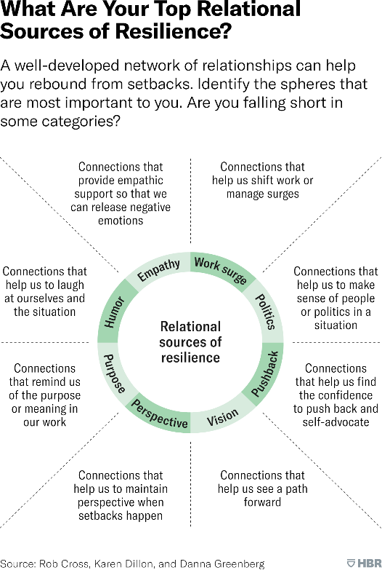
Build Resilience
Resilience needs are personal and are shaped by our unique history, personality, and personal circumstances. The relationships we develop are a toolbox that we can turn to in difficult times to help us navigate day-to-day life challenges.

Slide 9


Chef Sham Hanifa
20 years ago, Chef Sham Hanifa arrived in Ireland from Malaysia. He grew up learning to cook from his grandmother and inspired by her started his culinary career. He worked his way up from kitchen porter to head chef. Sham moved to Leitrim in 2008, He had a dream of owning a restaurant and it became a reality in the acclaimed The Cottage Restaurant. He owns a few others now along with a sauces line. He believes in learning from challenges and that being your authentic self will guide you to accomplish your dreams. Now that’s resilience!

Slide 10

Resilience Plan (4 S’s)
This exercise can help you set goals for improving your resiliency and making sure you keep your resilience building on track.
Identify a recent experience in which demonstrating resilience helped you overcome adversity. Working through the grid, you’ll then learn about the 4 S’s of resilience and how they helped you cope at the time
“
“We will either find a way or make one”.
Hannibal
10
10

Slide 11



Supportive People
People who gave you advice, or perhaps helped you develop a new, more helpful perspective
Strategies
Methods and approaches you implemented to deal with difficult thoughts and feelings
Sagacity
Wisdom and insights that may have been helpful.
Solution
Seeking behaviours. Planning, for instance, or searching for useful information.
11

Slide 12
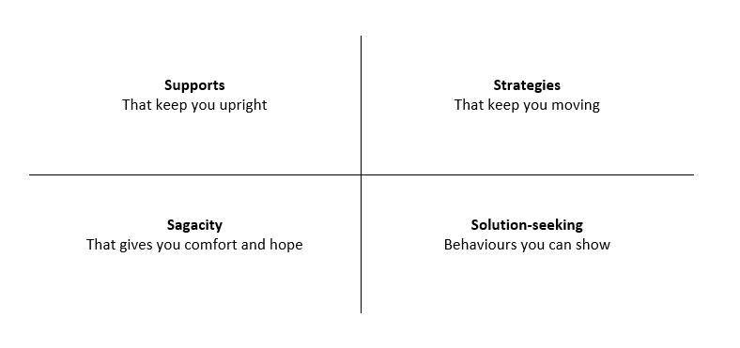
Follow by identifying a current challenge you’d like to deal with by applying your resilience plan. Complete the grid worksheet.
Resilience is like many other skills or abilities since to truly build meaningful resilience, it must be a practice.
12

Slide 13

SECTION
02
Cross-Cultural Communication

Slide 14
What do we mean by cross-cultural communication?
Cross-cultural communication refers to the communication between people who have differences in any one of the following:
Work style
Age
Nationality/ethnicity
Race
Gender
Sexual orientation
Cross-cultural communication can also refer to attempts made to exchange, negotiate, and mediate cultural differences by means of language, gestures, or body language.
14

Slide 15

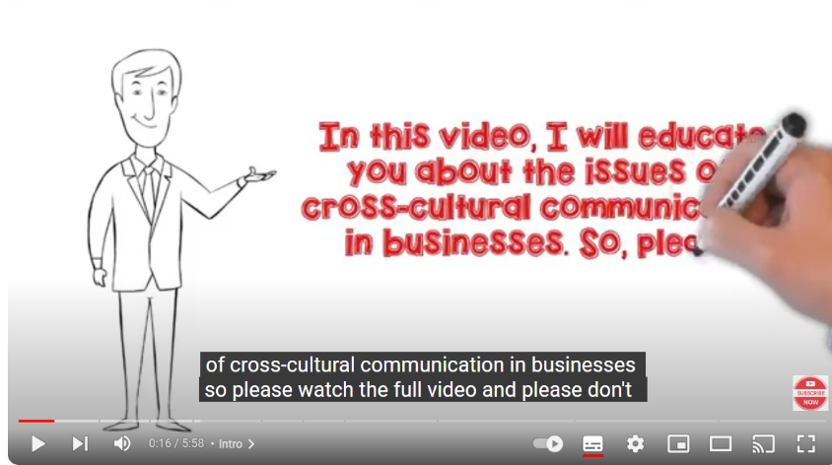
Your Heading
Watch this video!
Learn more about Cross-Cultural Communication in business.
15

Slide 16

Mamobo Ogoro is a social entrepreneur based in Dublin, Ireland. Her company Gorm has a vision to build an understanding that difference does not mean division. They want to bridge community and industry through a unique blend of digital media and evidence-based intercultural training and consultancy.
Gorm is a non-partisan and non-religious social enterprise that focuses on a human-first approach engaging across lines of difference through media-related projects, and intercultural training programmes. Their values in realizing their vision of unity are:
Unity: People-centred approach to bridge building
Openness to Difference: Embracing human & social differences.
Respect: Treating others the way you want to be treated.
Integrity: Knowing and doing what is right.
Inclusivity: Embracing opportunities to contribute.
Human Rights: Protecting the civil, political, economic, cultural, and social rights of human beings.

Slide 17
Tips for Effective Cross-Cultural Communication
1. Maintain etiquette
Many cultures have specific etiquette around the way they communicate. Before you meet, research the target culture, or if time allows, do some cross-cultural training. Every culture has its specific way of indicating this formality: ‘Herr’ and ‘Frau’ in Germany, reversing family and given names in China, and the use of ‘san’ in Japan for men and women, etc. Be aware of these familiarity tokens and don’t jump straight to first-name terms until you receive a cue from the other person to do so.
“
"Tolerance, inter-cultural dialogue and respect for diversity are more essential than ever in a world where peoples are becoming more and more closely interconnected."
Koffi Annan
Former Secretary-General of the United Nations
17
17

Slide 18

2. Avoid slang
Most educated non-native English speaker will have a comprehensive understanding of English slang, idioms, and sayings. They may understand the individual words you have said, but not the context or the meaning. As a result, you could end up confusing them or offending them.
3. Speak slowly
Even if English is the common language in a cross-cultural situation, it’s not a good idea to speak at your normal speed. Speaking at a slower rate will help, as well as clearly, and pronouncing your words properly. Break your sentences into short, definable sections, and give your listener time to translate and digest your words as you go. But don’t slow down too much as it might seem patronizing. If the problem is reversed don’t be afraid to politely ask them to slow down.

Slide 19

4. Keep it simple
In a cross-cultural conversation, there’s no need to make it harder for both of you by using big words. Just keep it simple. Two-syllable words are much easier to understand than three-syllable words, and one-syllable words are better than two-syllable words.
5. Practice active listening
Active listening is a very effective strategy for improving cross-cultural communication. Restate or summarise what the other person has said, to ensure that you have understood them correctly, and ask frequent questions. This helps to ensure that important information doesn’t get missed or misunderstood.
19

Slide 20

6. Take turns to talk
Make the conversation flow more freely by taking turns to speak. Make a point and then listen to the other person respond. Particularly when people are speaking English as their second language it’s better to talk to them in short exchanges rather than delivering a long monologue that might be difficult for them to follow.
7. Write things down
If you’re not sure whether the other person has understood you properly, write it down to make sure. This can be particularly helpful when discussing large figures.
8. Avoid closed questions
Don’t phrase a question that needs a ‘yes’ or ‘no’ answer. In many cultures it is difficult or embarrassing to answer in the negative, so you will always get a ‘yes’ even if the real answer is ‘no’. Ask open-ended questions that require information instead.
20

Slide 21

9. Be careful with humour
Many cultures take business very seriously and believe in behaving professionally and always following protocol. As a result, they don’t appreciate the use of humour and jokes in a business setting. If you use humour, make sure it will be understood and appreciated in the other culture and not offend.
10. Be supportive
Effective cross-cultural communication is about all parties feeling comfortable. In any conversation with a non-native English speaker, treat them with respect, do your best to communicate clearly, and encourage them when they respond. This will help build confidence and trust in you.
21

Slide 22

SECTION
03
Building Self Confidence

Slide 23

What do we mean by self-confidence?
It is a quality that promotes and strengthens your belief in your abilities. Self-confidence enables individuals to develop faith in their competencies and to trust their judgments, decisions, and skills.
High levels of self-confidence can motivate professionals to complete challenging tasks and address complex problems.
Self-confident individuals may be able to reflect upon their strengths and weaknesses and assess situations to contribute solutions to problems.

Slide 24



Characteristics of self confidence people
24
24

Slide 25
Believe in Themselves
Confident people often take part in and contribute to group discussions. They present their thoughts and opinions confidently as they have faith in their judgment, skills, and approach to professional tasks.
Voices their Opinion
A key characteristic of confident people is that they follow through in action, with what they believe is right. As a self-assured person, you might be open to taking feedback from peers before making your final decision. Self-confident people may also put forward their views in a composed manner.
25

Slide 26



Takes on new challenges
Trust in your abilities may enable you to seek challenges to test and accumulate experience and knowledge. A self-confident person usually believes that they can successfully overcome difficulties they face, by applying relevant skills, knowledge, or experience.
Accept criticism positively
Success and failure are both possible in professional and personal life. A self-confident person will have the capacity to accept both praise and criticism constructively. They may be more inclined to listen to feedback and use it to overcome challenges.
26

Slide 27
Building self confidence
Talk it out!
Whatever worries or negative thoughts you have, there is always something you can do to feel better. Talk to someone. This person can be a family member, a friend, or a health professional. Talking helps to get a different perspective on a problem. It will also help you to see things clearer. Find the good things. Think about the things you like about yourself and the things you have done that make you feel good. Concentrate on the positive things about yourself. This will help build your self-confidence.
Keep a Gratitude Journal
List 5 things you feel grateful for each day.
27

Slide 28
Building self confidence
Do good deeds
Helping someone else will make you feel good too. Try doing 3 nice things a day for others.
Enjoy the journey
Make sure you have fun and do things you enjoy. This will make you feel happier and more positive about yourself.
Do not be too hard on yourself!
If you make a mistake or things do not go as you want, try to be kind to yourself. Instead of criticizing yourself, learn from what happened. Think about what you might do differently in the future.
28

Slide 29




New Connections
Jaky Romero
New Connections is an educational travel company based in Leitrim, Ireland. They bring people from Nicaragua to Ireland who want to learn English, work, and immerse themselves in a different culture. Jaky had former experience working in a travel agency in the past. She enjoys helping people so wanted to help students experience another culture and learn English. She saw a niche to bring language learning and tourism together. She was self-confident in being able to bring to reality a business that did just this. She researched, asked questions, and formed partnerships. She now owns a successful business in Ireland.

Slide 30
SECTION
04
Embracing a Global Perspective & Utilizing a Global Advantage

Slide 31
Global Perspective
A global perspective is seeing and understanding how any situation impacts or relates to people around the world.
When we think globally, it leads us to stay ahead of changes that come. You are ahead in business if you can perceive economics, politics, sociology, and any other fields from a global perspective.

Slide 32
Global perspectives are important because:
1. Inspires creativity
A study by Scientific American titled “How Diversity Makes Us Smarter” shows that socially diverse groups are more innovative than homogenous groups. In other words, people from all walks of life will produce more unique solutions and positive results.
2. Makes you an agent of change
You can be an agent of change, whether you’re a student, intern, employee, or entrepreneur. It won’t be easy, but you will need to see what’s already been done and adapt it to serve your community.
3. Your hiring potential increases
According to Forbes, the number one skill sought by employers is creativity. This is still true today, and thinking globally means you can look beyond what’s in front of you. Being able to accept diverse viewpoints also strengthens your collaboration skills.
32

Slide 33
How do we adopt a global perspective?
Be open to critique!
You must be able to be honest about any failings and willing to meticulously deconstruct each of them to see where you and your colleagues might improve things.
Are you open to new ideas, or do you make assumptions?
Can you fail to be self-aware at times?
Do you have more to learn about the plights of others?
Ask employees whether you could be doing more. They may have insightful suggestions that you can accommodate, such as charitable endeavours, recruitment drives, and policy changes. Make sure everyone feels comfortable contributing to an ongoing discussion.
33

Slide 34
Book an online course with your team
Ensure changes progress steadily by booking your places on an online business international relations course as a group. Let your leaders know that you’re willing to invest in further career development. Prove to your staff that you’re not above further learning yourself. The result is that you will build a culture, too, rather than be the sole instigator of business change.
Improve cross-cultural networking
Remember that networking varies from location to location. It may be prudent to watch and learn at physical events, to begin with. What customs are in effect? How do professionals' approach and engage one another? What kinds of small talk do attendees seem to favour? You can harness all this knowledge during your efforts later. Once your business is connected to a cross-cultural network, the ability to adopt a more global perspective can become easier. You’ll be able to liaise with clients who regularly have insights to share, even in terms of off-hand comments and small talk. It will all increase your exposure to different points of view.
34

Slide 35
Push for diversity
Recruitment is a big factor in driving a global perspective in business. If you can hire people from different parts of the world, these professionals will incorporate their experiences into their positions. Once a worker is hired, try not to treat this as the ‘end’ of the process. After contracts are signed, you can then try to utilize their connections too. Perhaps they could refer you to other hard-working professionals from other walks of life?
Support charities
Non-profit organizations are devoted to being knowledgeable about world events. They have resources making working with them a promising way to develop your business’ global perspective. Many charities also take on an informative role. They’ll have the latest evidence and statistics that justify the help they provide overseas. Additionally, if your business has a working relationship with them or even simply donates, you and your staff could receive updates on how the situation is developing and what is being done to address key issues.
35

Slide 36

Eno Eka, a Canadian Business Analyst, Consultant, and CEO, is the driving force behind Eny Consulting and the Business Analysis School. She has leveraged her entrepreneurial spirit to create a seven-figure global company.
The pandemic was a turning point for Eno, forcing her to transition from employee to entrepreneur overnight. Faced with this crisis, Eno founded Eny Consulting and created an educational platform to help companies and professionals pivot into technology.
Eno’s journey demonstrates the power of resilience, adaptability, and unwavering focus. Her philosophy, “focus on impact, and the income will follow”, has guided her throughout her journey. Today, her companies have reached over 100,000 professionals in 90 countries, affirming that it’s possible to turn crises into opportunities for growth and impact

Slide 37
Benefits of a Global Mindset
Cultural Awareness
Understanding and appreciating cultural differences is crucial in a globalized business. International business skills teach entrepreneurs to navigate different cultures, customs, and communication styles. This cultural awareness not only helps build stronger relationships with international partners and customers but also reduces the likelihood of cultural misunderstandings that can harm business relationships.

Slide 38

Access to a diverse pool of people
Successful start-ups often require a diverse set of skills and talents. By embracing international business skills, entrepreneurs can tap into a global talent pool. You can hire individuals with unique backgrounds and perspectives, fostering innovation and creativity within your start-up. This diversity can lead to more effective problem-solving and a broader range of ideas.
Networking opportunities
Networking is a cornerstone of entrepreneurship, and international business skills provide entrepreneurs with a broader network. Attending international conferences, trade shows, and business events can lead to valuable connections across borders. These connections may open doors to partnerships, collaborations, and investment opportunities that might not have happened otherwise.

Slide 39
Adaptability to resilience
Operating in the international arena requires a high degree of adaptability and resilience. Entrepreneurs with international business skills are better equipped to weather economic, political, and cultural fluctuations. They can pivot their strategies and business models more effectively when faced with unexpected challenges, reducing the risk of failure.
Access to global resources
International business skills can also help start-ups access global resources such as funding, suppliers, and technologies. In addition, entrepreneurs can use global research and development initiatives to stay at the forefront of innovation.
Competitive advantage
Many industries are global in nature, and entrepreneurs who can effectively operate on an international scale are more likely to stay ahead of the competition. Being able to offer products or services that meet the needs of a diverse global market can lead to sustained growth and success.
39

Slide 40
Market expansion
One of the primary benefits of international business skills is the potential for market expansion. Rather than limiting your start-up to a single domestic market, having the knowledge and skills to explore international markets opens a world of possibilities. Expanding globally allows you to tap into larger customer bases, diversify your revenue streams, and reduce the risk associated with relying solely on one market.

Slide 41
SECTION
05
Mental Wellbeing
& Support Resources

Slide 42

Mental Wellbeing
Entrepreneurship is exciting and stressful! This is why we must address wellbeing and support available for those who own a business.
In the competitive world of entrepreneurship, it's easy to overlook the importance of mental health. The pursuit of success can lead to neglecting your well-being, resulting in a range of mental health challenges. Addressing these challenges is crucial for long-term success and personal accomplishment.
“
“Self-care is not self-indulgence, it is self-preservation.”
Audre Lorde
42
42

Slide 43


Tips for entrepreneurs to manage stress
Maintain a healthy work-life balance: It's essential to set boundaries between work and personal life. Dedicate time for relaxation, hobbies, and spending quality time with loved ones.
Practice self-care: Engage in activities that promote relaxation and well-being, such as exercise, meditation, or pursuing a hobby. Taking care of your physical health can have a positive impact on your mental well-being.
Seek professional help when needed: Don't hesitate to reach out to mental health professionals if you find yourself struggling. Therapy or counselling can provide valuable insights, coping mechanisms, and support to navigate the challenges of entrepreneurship.
43

Slide 44

Tips for entrepreneurs to manage stress
Foster a supportive work culture: If you have employees, create an environment that promotes mental well-being. Encourage open communication, offer resources for mental health support, and lead by example in prioritizing self-care.
Embrace failure as a learning opportunity: Entrepreneurship is filled with successes and failures. Instead of letting failures define you, view them as opportunities for growth and learning. Be able to bounce back from challenges.
44

Slide 45


Your Heading
Listen!
In this podcast, Emma Sheppard, a freelance journalist, shares how entrepreneurs can spot the signs they may be approaching burnout. What positive habits they can adopt to achieve a better work-life balance. Also, what other support is available to them if they feel they need it.
45

Slide 46
Online Support Resources
Be You Planning for Wellbeing: mine, yours, ours
Suggested activities, guidance and inspiration to help you find the balance in all areas of your life while navigating the ups and downs.
https://beyou.edu.au/-/media/resources/tools-and-guides/wellbeing-tools-for-you/practice/be-you-planning-for-wellbeing--mine-yours-ours.pdf
“
“There is no health without mental health; mental health is too important to be left to the professionals alone, and mental health is everyone’s business.”
Vikram Patel
46
46

Slide 47
Black Dog Institute: Digital Tools and Resources
Collection of quizzes for self-assessment and apps to help with mild to moderate conditions.
https://www.blackdoginstitute.org.au/resources-support/digital-tools-apps/
Headspace
Headspace is a science-backed app for mindfulness and meditation, providing unique tools and resources to help reduce stress, build resilience, and aid better sleep.
https://www.headspace.com/nhs
47

Slide 48
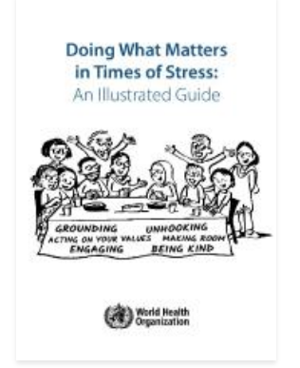

Doing What Matters in Times of Stress: An Illustrated Guide by World Health Organization
A stress management guide for coping with adversity. The guide aims to equip people with practical skills to help cope with stress. A few minutes each day are enough to practice the self-help techniques. The guide can be used alone or with the accompanying audio exercises. Available in several languages!
CLICK TO READ
48

Slide 49

A Facebook group to join that may be helpful!
Migrant Minds- A European Network of Immigrant Entrepreneurs and Professionals. Our mission is to inspire others! Join our pool of immigrants, reach like-minded people, discover new success stories, get inspired, and inspire others.
49
49

Slide 50

www.ingrow.eu
Follow our journey

