Slide 1
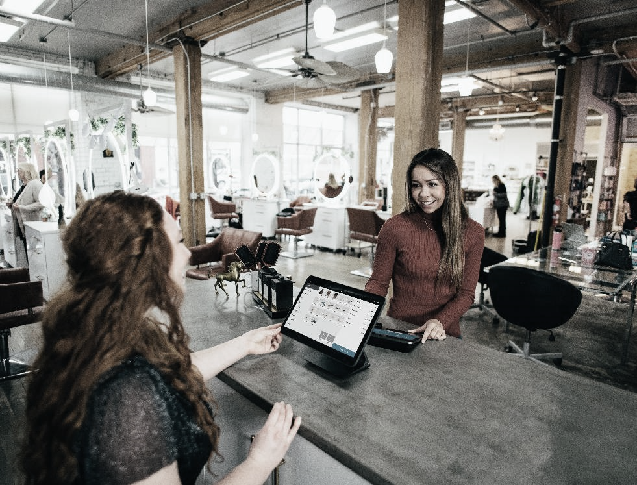

Module 2
MIGRANT ENTREPRENEURS EQUIPPED WITH KNOWLEDGE AND INFORMATION
www.ingrow-project.eu
This resource is licensed under CCBY 4.0

Slide 2
TABLE OF CONTENTS
01
Enhancing Language Skills of Migrant Entrepreneurs in the Business World
Relevant Legal and Regulatory Knowledge in Business
02
03
Common Challenges Faced by Migrant Entrepreneurs in Business Creation
04
Strengths of Migrant Entrepreneurs and Assessment of Individual Entrepreneurs Capabilities
05
Development of a Business Plan
06
Case Studies
2

Slide 3

SECTION
01
ENHANCING LANGUAGE SKILLS OF MIGRANT ENTREPRENEURS IN THE BUSINESS WORLD

Slide 4

IMPORTANCE OF ENHANCING LANGUAGE SKILLS FOR MIGRANT ENTREPRENEURS
When moving and settling down to a new country, enhancing our language skills is essential for integration in the local community.
As migrant entrepreneurs this will increase business opportunities and widens social network that can bring a positive influence when starting a business in a host country (Wei et. al, 2018)
4
Notes:
Source: Wei, Xiahai and Jiao, Yang and Growe, Glenn, The Making of Entrepreneurship: Does Language Ability Matter? (January 13, 2018). Small Business Economics, Available at SSRN: https://ssrn.com/abstract=3139384 or http://dx.doi.org/10.2139/ssrn.3139384

Slide 5

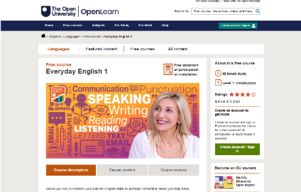
LEARNING RESOURCES TO ENHANCE BUSINESS ENGLISH
The following are learning resources to support migrant entrepreneurs in practicing English, the universal language:
1.Everyday English Free Online Course by Open Learn University
Website:
https://www.open.edu/openlearn/languages/everyday-english-1/
https://www.open.edu/openlearn/languages/everyday-english-2
2. English Test and Beginner to Advance English Lessons
Website: https://www.english52.com/
5
Notes:
Additional Resources For Educators and Organizers of Language Support Activities:
Council of Europe
https://www.coe.int/en/web/language-support-for-adult-refugees/list-of-all-tools

Slide 6

LEARNING RESOURCES TO ENHANCE BUSINESS ENGLISH
3. Talk English – Community that support to improve language skills
Website: https://www.talk-english.co.uk/introduction/learners-introduction/
4. English Online Various Study Course offered by British Council
Website: https://www.britishcouncil.org/english/learn-online
5.Say Hi Application – conversational translation
Website: https://www.sayhi.com/en/translate/
6

Slide 7


LEARNING RESOURCES TO ENHANCE BUSINESS ENGLISH
7.Perfect English Grammar – Practice grammar worksheets, guides and worksheets to brush up language skills
Website: https://www.perfect-english-grammar.com/
8. Spotlight Podcast –Listen to English Speakers
Website: https://spotlightenglish.com/
also available at spotify and youtube
7

Slide 8

SECTION
02
RELEVANT LEGAL AND REGULATORY KNOWLEDGE IN BUSINESS FOR MIGRANT ENTREPRENEURS

Slide 9
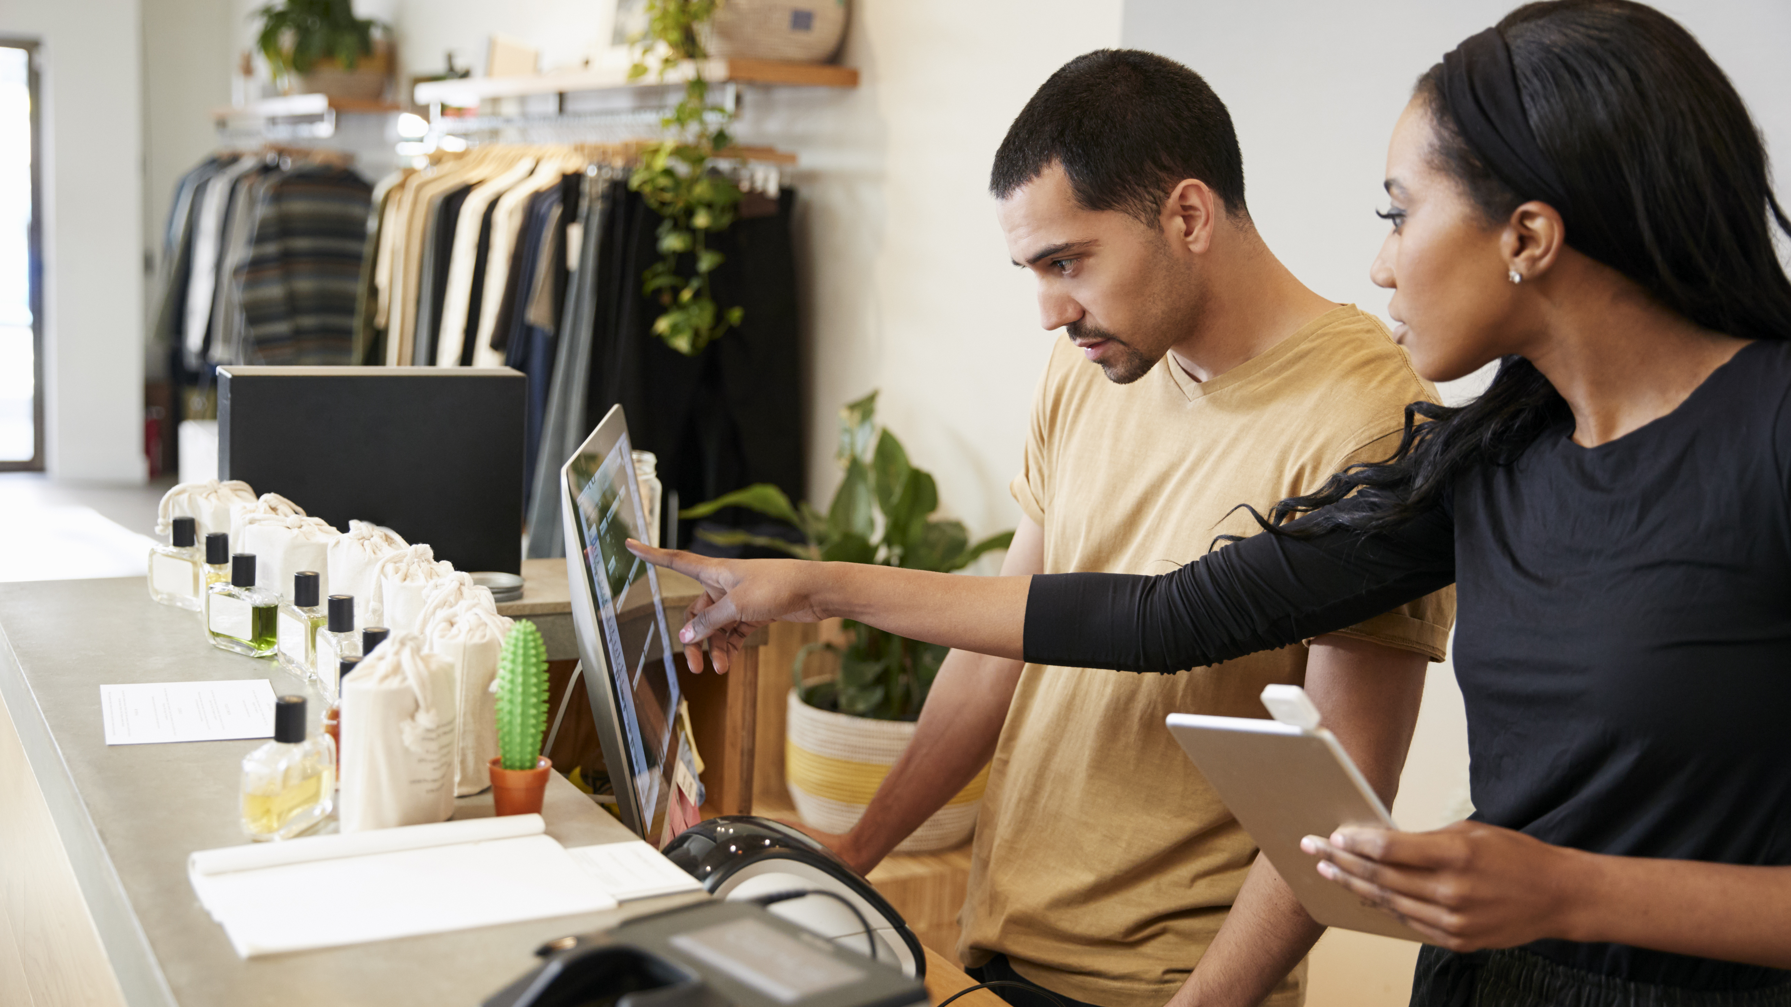
Legal and Regulatory Knowledge Relevant to Migrant Entrepreneurs
Understanding legal and regulatory requirements is crucial for migrant entrepreneurs. This section provides an overview of key areas such as business registration, employment laws, and industry-specific regulations.

Slide 10

Overview of Business Registration
Each country has its own set of laws, regulations, and procedures for setting up a business. This diversity means that what applies in one country might not apply in another. Below are the most “Common Business Structures”:
Sole Proprietorship:
Description: The simplest form of business, owned and operated by one person.
Common in: Small businesses, freelance operations, and startups.
Notes:
References:
Business Structures: https://corporatefinanceinstitute.com/resources/management/business-structure/
Indeed’s Guide to Business Structures: 5 Types and Their Advantages: https://www.indeed.com/career-advice/career-development/business-structure

Slide 11

Overview of Business Registration
Partnership:
Description: A business owned by two or more individuals who share profits, losses, and liabilities.
Variants: General Partnerships, Limited Partnerships, Limited Liability Partnerships (LLPs).
Common in: Professional services like law firms, accounting firms, and medical practices.
Limited Company (Ltd):
Description: A separate legal entity from its owners (shareholders). Owners have limited liability.
Variants: Private Limited Companies (Ltd), Public Limited Companies (PLC).
Common in: Medium to large-scale businesses
Notes:
References:
Business Structures: https://corporatefinanceinstitute.com/resources/management/business-structure/
Indeed’s Guide to Business Structures: 5 Types and Their Advantages: https://www.indeed.com/career-advice/career-development/business-structure

Slide 12
Useful resources to check out for Business registration
Germany: If you are interested in starting a business in Germany, we recommend this page from the Federal Government as well as Gruenderplattform.
Here you will find valuable tips, addresses and further information on required steps that you should submit for setting up a business. For more information on the legal business forms in Germany, we recommend the overview here.
Sweden: www.verksamt.se The place to go to registers your business step by step
https://www.nyforetagarcentrum.com/ Free help for starting a business
https://www.almi.se/ Free help on business development and funding
https://coompanion.se/ Free help on business development for social businesses

Slide 13
Useful resources to check out for Business registration
Ireland: To register a business in Ireland go to the Company Registration Office here where they guide you and provide the forms to fill out. You can also go to the Revenue website to find guidance and more details on setting up a business. We recommend Citizen's Information as well for step by step information.
Denmark:To register a business in Denmark, visit the Danish Business Authority's website at Virksomhedsregistrering which will guide you through the process and provide the necessary forms. Additionally, you can visit the Danish Tax Agency's website at Skattestyrelsen for guidance and more details on setting up a business. We also recommend the Business in Denmark website at Business in Denmark for step-by-step information.

Slide 14

Steps and Requirements for Business Registration
This section will discuss the process, covering the essentials from initial research and choosing a business name to handling key legal formalities like tax registration and securing necessary licenses. It's designed to provide you with a clear pathway for setting up your business legally and effectively, tailored to your unique business type and location.

Slide 15

Initial Research in Business Registration: Understanding the Local Business Climate
Market Dynamics: Start by getting a feel for the local market. What are the current trends? Who are the major players? This knowledge can help you position your business effectively.
Competitor Analysis: Look at similar businesses in the area. What are they offering? How are they pricing their services or products? Understanding your competition is key to finding your niche.
Legal Requirements: Every location has its own set of rules for businesses. This can include specific permits, health and safety regulations, and employment laws. Familiarising yourself with these requirements is crucial to ensure compliance and avoid legal pitfalls.
Notes:
References:
21 things to research before starting a business: https://www.transmitstartups.co.uk/business-planning/21-things-to-research-before-starting-a-business
How to Start a Business: A Startup Guide for Entrepreneurs: https://blog.hubspot.com/sales/how-to-start-a-business
How to conduct market research for your business idea: https://www.tide.co/blog/business-tips/market-research/
The Legal Requirements To Consider When Setting Up Your Business In Europe: https://bridgeheadagency.com/legal-requirements/

Slide 16

Initial Research in Business Registration: Leveraging Local Resources
Online Portals and Government Websites: Many governments provide comprehensive online resources for new businesses. These can include step-by-step guides, downloadable forms, and detailed explanations of legal requirements.
Business Advisory Services: Many areas offer free or low-cost advisory services for new entrepreneurs. These services can provide personalized guidance and answer specific questions you might have.
Networking Opportunities: Connect with local business owners and industry groups. They can offer invaluable insights from their own experiences and may provide tips on navigating the local business landscape.
Notes:
References:
21 things to research before starting a business: https://www.transmitstartups.co.uk/business-planning/21-things-to-research-before-starting-a-business
How to Start a Business: A Startup Guide for Entrepreneurs: https://blog.hubspot.com/sales/how-to-start-a-business
How to conduct market research for your business idea: https://www.tide.co/blog/business-tips/market-research/
The Legal Requirements To Consider When Setting Up Your Business In Europe: https://bridgeheadagency.com/legal-requirements/

Slide 17

Case example: Business Setup in Dublin, Ireland
Scenario: Imagine you are an entrepreneur planning to open a coffee shop in Dublin.
Market Research: You would start by researching the local café scene in Dublin, understanding popular trends such as organic coffee or vegan pastries, and identifying key areas in the city where coffee shops thrive.
Regulatory Research: Next, you would look into specific regulations for food businesses in Ireland, such as health and safety standards, food hygiene certificates, and any special permits required by Dublin City Council.
Utilising Resources: Utilising resources like the 'Local Enterprise Office' in Dublin for advice, attending workshops or events held by the Dublin Chamber of Commerce, and joining local business networks can provide a wealth of information and support.

Slide 18

Choosing a Business Name: Balancing Creativity and Compliance
Reflecting Your Brand: The name of your business is often the first impression you make. It should be catchy, memorable, and encapsulate the essence of what your business offers.
Cultural Considerations: Consider the cultural context and language of the area where you will operate. A name that works well in one language or culture might have unintended meanings or connotations in another.
Compliance with Regulations: It's important to ensure that your chosen name doesn't infringe on existing trademarks. In many places, this means conducting a search through national or regional trademark databases.
Notes:
References:
How to Pick the Best Name for Your Company: https://hbr.org/2022/03/how-to-pick-the-best-name-for-your-company
7 useful tips on choosing a business name: https://big-idea.biz/brand-names/choosing-business-name/
Choosing A Company Name (Legal considerations): http://www.eurobusgroup.com/choosing-a-company-name#:~:text=Naming%20rules&text=The%20name%20cannot%20be%20very,the%20end%20of%20the%20name.

Slide 19

Choosing a Business Name: The Registration Process
Local Business Name Registries: Before finalising your business name, check with the local business registry to ensure the name isn't already in use.
Registration Formalities: Once you've confirmed the availability and compliance of your business name, the next step is to officially register it with the local business registration authority. This process might involve some paperwork and a registration fee.
Protecting Your Brand: Consider registering your business name as a trademark. This offers legal protection for your brand and prevents others from using a name that's too similar to yours.
Notes:
References:
How to Pick the Best Name for Your Company: https://hbr.org/2022/03/how-to-pick-the-best-name-for-your-company
7 useful tips on choosing a business name: https://big-idea.biz/brand-names/choosing-business-name/
Choosing A Company Name (Legal considerations): http://www.eurobusgroup.com/choosing-a-company-name#:~:text=Naming%20rules&text=The%20name%20cannot%20be%20very,the%20end%20of%20the%20name.

Slide 20

Case example: Starting a Business in Berlin, Germany
Scenario: Imagine you're an entrepreneur planning to open a boutique design studio in Berlin.
Name Selection: You might come up with a name that blends creativity with a touch of German culture, such as "KreativKunst Studio."
Research for Compliance: You would need to check this name against the German Trademark and Patent Office (Deutsches Patent- und Markenamt, DPMA) to ensure it's not already in use or trademarked.
Registration Process: After confirming its availability and compliance, you would register your business name with the local Handelsregister (Commercial Register) in Berlin. You might also want to consider protecting your brand name by applying for a trademark through the DPMA.

Slide 21

Registration Documents for Business Setup
Personal Identification: Valid identification is the first step in establishing your business identity. This is usually a passport or a national ID card. For migrants or refugees, it’s important to ensure that your identification documents are recognised in the country where you are setting up your business.
Crafting a Business Plan: A well-thought-out business plan is not just a requirement for registration but also a roadmap for your business's future. It should clearly outline your business objectives, target market, competitive landscape, marketing and sales strategies, operational plan, and financial projections. This document is essential for understanding your business goals and for presenting your vision to potential investors or partners.
Notes:
References
Starting a business: https://europa.eu/youreurope/business/running-business/start-ups/starting-business/index_en.htm
How to Register a Company in Europe: https://www.openaeuropeancompany.com/blog/how-to-register-a-company-in-europe/
Starting a Business in Ireland? Requirements for Company Formation: https://www.companyformations.ie/company-formations/starting-a-business/
How to start a company in Germany: Your company formation checklist: https://www.firma.de/en/company-formation/how-to-register-a-company-in-germany-a-company-formation-checklist/
Moving to Sweden to start a business: https://www.verksamt.se/web/international/starting/moving-to-sweden-to-start-a-business

Slide 22

Registration Documents for Business Setup
Proof of Address: Demonstrating a stable business location is crucial. This can typically be a lease agreement for your business premises or a recent utility bill in the name of the business. This address will be used for official communications and must comply with zoning regulations if applicable.
Notes:
References
Starting a business: https://europa.eu/youreurope/business/running-business/start-ups/starting-business/index_en.htm
How to Register a Company in Europe: https://www.openaeuropeancompany.com/blog/how-to-register-a-company-in-europe/
Starting a Business in Ireland? Requirements for Company Formation: https://www.companyformations.ie/company-formations/starting-a-business/
How to start a company in Germany: Your company formation checklist: https://www.firma.de/en/company-formation/how-to-register-a-company-in-germany-a-company-formation-checklist/
Moving to Sweden to start a business: https://www.verksamt.se/web/international/starting/moving-to-sweden-to-start-a-business

Slide 23

Case Example: Starting a Business in Copenhagen, Denmark
Scenario: Imagine you are a entrepreneur planning to open an artisan bakery in Copenhagen.
PART 1
Personal Identification: As an expatriate, you would use your passport or residence permit as official identification for business registration purposes.
Business Plan: Your business plan would detail your concept of a bakery specialising in artisan breads and pastries, focusing on organic and locally sourced ingredients. It should include market research showing the demand for such products in Copenhagen, marketing strategies to attract customers, and financial projections for the first few years.

Slide 24
Case Example: Starting a Business in Copenhagen, Denmark
Scenario: Imagine you are a entrepreneur planning to open an artisan bakery in Copenhagen.
PART 2
Proof of Address: For your bakery, you would provide a lease agreement for the shop located in a busy neighbourhood of Copenhagen, ensuring it aligns with local business zoning laws.
Registration Process: With these documents, you would approach the Danish Business Authority (Erhvervsstyrelsen) to register your business. In Denmark, this process is streamlined and can often be done online through their portal.

Slide 25

Legal Formalities in Business Registration: Navigating Legal & Financial Requirements
Tax Identification:
A tax ID or employer identification number (EIN) is crucial for any business. This unique identifier is used for all your business-related tax dealings. It's essential for filing tax returns, hiring employees, and more.
In most countries, obtaining a tax ID is one of the first steps after registering your business. This process can usually be done through the national tax authority’s website or office.
Notes:
References:
TIN - Taxpayer Identification Number: https://taxation-customs.ec.europa.eu/online-services/online-services-and-databases-taxation/tin-taxpayer-identification-number_en

Slide 26

Legal Formalities in Business Registration: Navigating Legal & Financial Requirements
Setting Up a Business Bank Account:
Opening a dedicated business bank account is vital for keeping your personal and business finances separate. This helps in managing your finances more effectively and is often a requirement for various business transactions.
When choosing a bank, consider factors like fees, services offered, and ease of international transactions if your business requires it.
Notes:
References
European banking services: https://www.nibusinessinfo.co.uk/content/what-you-will-need-set-your-business-account-europe
How to open a business bank account in Europe: https://gocardless.com/guides/posts/how-to-open-a-business-bank-account-in-europe/#:~:text=The%20required%20documents%20for%20opening,such%20as%20articles%20of%20incorporation.
Opening a Business Bank Account in the EU As a Non-Resident: https://silverbird.com/blog/articles/opening-a-business-bank-account-in-the-eu-as-a-non-resident

Slide 27

Legal Formalities in Business Registration: Navigating Legal & Financial Requirements
VAT Registration:
Value Added Tax (VAT) registration is required for businesses that exceed a certain revenue threshold. This threshold varies by country.
Registering for VAT is important as it allows you to charge VAT on your products or services and claim it back on your purchases. It's a critical aspect of managing your business's tax responsibilities.
Notes:
References:
HOW TO GET A VAT NUMBER IN THE EU: https://quaderno.io/blog/vat-number-business-europe/

Slide 28

Case Example: Starting a Business in Stockholm, Sweden
Scenario: Imagine you are planning to start a technology consultancy in Stockholm.
PART 1
Tax ID: In Sweden, you would apply for an Organisationsnummer, the Swedish equivalent of a tax ID, through the Swedish Tax Agency (Skatteverket). This number is essential for all your business operations in Sweden.
Business Bank Account: After obtaining your Organisationsnummer, you would approach a bank in Sweden to open a business account. Banks like Nordea and Handelsbanken, which are accustomed to working with businesses, can offer accounts with features beneficial for a consultancy.

Slide 29
Case Example: Starting a Business in Stockholm, Sweden
Scenario: Imagine you are planning to start a technology consultancy in Stockholm.
PART 2
VAT Registration: Given that your consultancy is expected to have significant revenue, you would register for VAT with the Skatteverket. In Sweden, this is a straightforward process, often completed online, and it's a key step in ensuring your business is tax-compliant.

Slide 30

Licenses and Permits for Business Compliance: Securing the Necessary Approvals
Understanding Industry-Specific Requirements:
Every business type has unique requirements when it comes to licenses and permits. It's essential to understand what applies to your business to operate legally.
For example, a restaurant might need a health permit, a retail store might require a sales license, and a professional service, like a consultancy, could need a specific professional license

Slide 31

Licenses and Permits for Business Compliance: Securing the Necessary Approvals
Process of Obtaining Licenses and Permits:
The process generally involves filling out applications, submitting necessary documentation, and sometimes paying a fee.
Some permits, especially those related to health and safety, might require an inspection of your business premises before approval.

Slide 32

Licenses and Permits for Business Compliance: Securing the Necessary Approvals
Local Compliance and Regulations:
Compliance with local regulations is not just about legality but also about the safety and well-being of your customers and the community. This includes adhering to health and safety standards, environmental regulations, and any other local laws.
Staying updated with local compliance requirements is crucial, as these can change over time.

Slide 33

Case Example: Starting a Business in Madrid, Spain
Scenario: Imagine you're an entrepreneur planning to open a digital marketing agency in Madrid.
PART 1
Licenses and Permits: In Madrid, for a digital marketing agency, you would first seek a 'licencia de apertura' (opening license) from the local municipality, ensuring your office space meets urban planning and safety norms.
Additional Requirements: Given the nature of the business, you might also need to register for data protection and privacy compliance, adhering to Spain's data protection laws (aligned with the EU's GDPR).

Slide 34
Case Example: Starting a Business in Madrid, Spain
Scenario: Imagine you're an entrepreneur planning to open a digital marketing agency in Madrid.
PART 2
Local Compliance: As your agency would operate in a highly digital environment, ensuring compliance with online advertising regulations and consumer protection laws is crucial.
Navigating the Process: In Madrid, the Madrid Emprende program can be a valuable resource, offering assistance in understanding these legalities and successfully establishing your digital marketing agency.

Slide 35
EU ENTREPRENEURSHIP 2020 ACTION PLAN
In 2015, small medium enterprises (SMEs) generated €3.9tn in value and employed 90 million Europeans which accounts for over 99% of all businesses in the Europe therefore having a great impact on EU economy (Muller, P et al. .,2016)
Align with this, The EU Entrepreneurship Action Plan was developed to strengthen Entrepreneurship in Europe
The plan outlines the importance of education and training of new entrepreneurship targeted young people, women, migrants, seniors and unemployed through a range of actions during the period of 2014-2020.
35
Notes:
Source:
Patrice Muller et al. (2016) ‘Annual Report on European SMEs 2015/2016’, Brussels: European Commission, 2016, 1, https://ec.europa.eu/jrc/sites/jrcsh/files/annual_report_-_eu_smes_2015-16.pdf.
EESC (2013). Entrepreneurship Action Plan 2020. https://www.eesc.europa.eu/en/our-work/opinions-information-reports/opinions/entrepreneurship-2020-action-plan

Slide 36
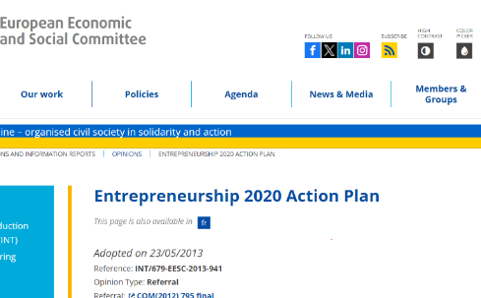
EU ENTREPRENEURSHIP 2020 ACTION PLAN
You may read more out the action plan here:
https://www.eesc.europa.eu/en/our-work/opinions-information-reports/opinions/entrepreneurship-2020-action-plan

Slide 37

““We have a lot of proof and we all know that Europe without migrants would have been a much less influential continent. The potential of immigrant entrepreneurs, for example, has been enormously important in the creation of new ideas and new jobs.”
- Olle SCHMIDT, Swedish MEP for the Alliance of Liberals and Democrats for Europe
37
Notes:
Source: https://www.theneweuropean.eu/eurovoices/immigrant-entrepreneurs-are-the-best-of-the-best-a-selection-of-mep-quotes

Slide 38
International Legal Framework for Protection of Migrant Workers
As Migrant Entrepreneurs it is important to be aware of the International policies regarding human rights of migrant workers and the standards for human and labour.
The United Nations and International Labor Migrant have strengthened policies to protect migrant workers and ensure equal opportunity, and treatment.
To know more about the international rights you may read it Organization for Security and Co-operation in Europe:
https://www.osce.org/files/f/documents/b/a/19246.pdf
38
Notes:
Source:
International Legal Framework for Protection of Migrant Workers
https://www.osce.org/files/f/documents/b/a/19246.pdf

Slide 39

SECTION
03
COMMON CHALLENGES MIGRANT ENTREPRENEURS FACE ON BUSINESS CREATION
Notes:
Source: OECD (2019), "Policy brief on refugee entrepreneurship", OECD SME and Entrepreneurship Papers, No. 14, OECD Publishing, Paris, https://doi.org/10.1787/70571d6f-en.

Slide 40
Challenges of Migrant Entrepreneurs:
Language and Cultural Barriers
When opening a new business, migrant entrepreneurs need to secure the right visa, start-up business permits. This can be challenging if the host country use limited universal and common languages making the administrative process longer and tedious due to the difficulty in understanding the regulations and requirements (OCED, 2019). Communicating and establishing business connection with potential customers and stakeholders can also be hard at the beginning.
Another challenge is the cultural differences of the local people and migrant entrepreneurs. This can lead to issues in cultural adaptation and navigation of the new business environment (Walsh, L and Cooney, T. 2023).
40
Notes:
Source:
OECD (2019), "Policy brief on refugee entrepreneurship", OECD SME and Entrepreneurship Papers, No. 14, OECD Publishing, Paris, https://doi.org/10.1787/70571d6f-en.
Walsh, L. and Cooney, T. (2023), "Understanding the interplay between immigrant nascent entrepreneurship and cross-cultural adaptation", Journal of Small Business and Enterprise Development, Vol. 30 No. 5, pp. 919-946. https://doi.org/10.1108/JSBED-12-2021-0472

Slide 41
Challenges of Migrant Entrepreneurs:
Lack of Access to Financial Resources and Grants
Many banks and investors are reluctant to fund and grant business loans to migrant entrepreneurs as they are perceived as high risk ( banks struggle to validate their credibility and financial history) so the next hurdle they face is accessing capital (OCED, 2019)
The state of financial ecosystem of a host country can have an impact on the operations and expansion of new start up business of migrant entrepreneurs.
Without financial support and funding available, it will be critical in setting off the business ( Davidavičienė, V., & Lolat, I. 2016).
41
Notes:
Source:
Davidavičienė, V., & Lolat, I. (2016). Migrant entrepreneurship in Europe: challenges and opportunities. In The 9th International Scientific Conference “Business and Management (pp. 1-14).
OECD (2019), "Policy brief on refugee entrepreneurship", OECD SME and Entrepreneurship Papers, No. 14, OECD Publishing, Paris, https://doi.org/10.1787/70571d6f-en.

Slide 42
Challenges of Migrant Entrepreneurs: Discrimination
Most often migrants entrepreneurs experience discrimination which can demotivate them in actively pursuing their new business start up and instead be employed in an company or organization.
Non-discrimination policies and better integration measures for immigrants should be implemented addressing stereotyping and biases (Naudé, W et. al 2017).
42
Notes:
Source:
Naudé, W., Siegel, M. & Marchand, K. Migration, entrepreneurship and development: critical questions. IZA J Migration 6, 5 (2017). https://doi.org/10.1186/s40176-016-0077-8

Slide 43




Self reflection: What other challenges of Migrant Entrepreneurs in business creation can you think of?
43
43

Slide 44



Lack of access to business information and advice
Immigrant entrepreneurs may not have the adequate business knowledge and advice of the host country rules in setting up the business
Lack of access to markets
Immigrant entrepreneurs may not have the adequate business knowledge and advice of the host country rules in setting up the business
44
Notes:
Source:
Manyi, E. (2010). Master Thesis Immigrant Entrepreneurship. Case Studies of challenges faced by immigrant entrepreneurs in a large and small Swedish city.

Slide 45
SECTION
04
Strengths of Migrant Entrepreneurs and Assessment of Individual Entrepreneurship Capabilities

Slide 46
Strengths of Migrant Entrepreneurs
According to research study conducted by Alexandra, D. et al, (2021) of the Institut Arbeit und Technik (IAT), there are three major characteristics of Migrant Entrepreneurs and these are:
Risk Taking Attitude – open to take business risks and see opportunities in the market
b) Perseverance and Creativity –maintains business endurance during uncertainty and approach business with innovate solutions
c)Transnational Embeddedness –use their specific knowledge, experiences and cultures for business stabilization
46
Notes:
Source:
David, Alexandra; Schäfer, Susann; Terstriep, Judith (2021) : Characteristics of migrant entrepreneurs: Asset in times of crisis?, Forschung Aktuell, No. 01/2021, Institut Arbeit und Technik (IAT), Gelsenkirchenhttps://www.econstor.eu/bitstream/10419/231383/1/1749298260.pdf

Slide 47


Impact Survey Entrepreneurship Competencies and Potential
Click to take the survey:
https://impactonyouth.eu/assessments/
Notes:
Source:
https://impactonyouth.eu/assessments/
https://impactonyouth.eu/user-register/

Slide 48

Impact Survey: Assessing Entrepreneurship Competencies
The IMPACT Program uses a highly robust tool consisting of 15 individual survey-type tests that
will provide one’s entrepreneurial competencies.
As Migrant Entrepreneurs being aware of one’s competencies and areas to improve is beneficial for the success of starting and operating a SMEs
Notes:
Source:
https://impactonyouth.eu/assessments/

Slide 49
Entrepreneurship Potential Self Assessment
The 10 minute questionnaire has 50 statements which you need to rate the best that describes your opinion
This will an opportunity to evaluate and self reflection on entrepreneurship traits
Click to take the self assessment
https://www.bdc.ca/en/articles-tools/entrepreneur-toolkit/business-assessments/self-assessment-test-your-entrepreneurial-potential
Notes:
Source: https://www.bdc.ca/en/articles-tools/entrepreneur-toolkit/business-assessments/self-assessment-test-your-entrepreneurial-potential

Slide 50
Self Reflection: What are your personal strengths as a Migrant Entrepreneurs you can capitalize on?
50
50

Slide 51
“I never put people with a migrant background aside. They really are the best of the best. Most of them really want to work, have strong family relations, and are more than equipped to start their own company.”
- Isabelle DURANT, Belgian MEP for the Greens/European Free Alliance:
51
Notes:
Source: https://www.theneweuropean.eu/eurovoices/immigrant-entrepreneurs-are-the-best-of-the-best-a-selection-of-mep-quotes

Slide 52
SECTION
05
DEVELOPMENT OF A BUSINESS PLAN

Slide 53
Importance of a Business Plan
A business plan is the road map and vision of your start up business.
It is important to be understand how to write an effective business plan as it will provide:
clarity on business goals and timeline
analysis on how to execute the business idea
illustration of strategy and operations
funding opportunities
management and plan for potential risks and treats
53
Notes:
Source:
https://openstax.org/books/entrepreneurship/pages/11-4-the-business-plan

Slide 54
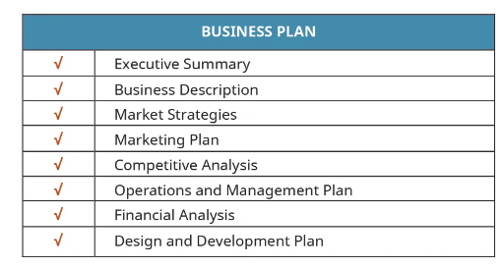
Basic Elements of a Business Plan
Image: Copyright Rice University, OpenStax, under CC BY 4.0 license
54
Notes:
Source:
https://openstax.org/books/entrepreneurship/pages/11-4-the-business-plan

Slide 55
Business Plan Checklist
A list of key questions to answer when developing and writing your business plans including template on projected income
Click to view a sample business plan checklist
https://studylib.net/doc/11852130/a-business-plan-checklist--key-questions-to-answer-organi...
Notes:
Source:https://studylib.net/doc/11852130/a-business-plan-checklist--key-questions-to-answer-organi...

Slide 56
“I think that we have to start looking at New Europeans not as part of the problem but as part of the solution. We have to change the picture: we should no longer consider them as a burden but as an asset. We need to recognise that we need migrants to sustain our economies. These people have come to our countries to enrich us.“
-Anna Maria CORAZZA BILDT, Swedish MEP for the European People’s Party
56
Notes:
Source: https://www.theneweuropean.eu/eurovoices/immigrant-entrepreneurs-are-the-best-of-the-best-a-selection-of-mep-quotes

Slide 57
SECTION
06
Case studies

Slide 58

Case Study: Startup Denmark
Startup Denmark is a visa scheme for non-EU, non-EEA and non-Swiss citizens. You apply on the basis of a business plan which is evaluated by an independent expert panel. If the panel approves your business plan, you are eligible to apply for a residence and work permit as a self-employed entrepreneur. The permit is granted for a period of up to two years with the possibility of extension for three years at a time. Who is eligible to apply?
Startup Denmark is for self-employed persons, and only non-EU (European Union), non-EEA (European Economic Area) and and non-Swiss citizens can apply.
Up to three non-EU/EEA citizens can submit a business plan as a team. If the business plan is approved by the Startup Denmark expert panel the applicants must apply individually for a residence and work permit from the immigration authorities.
A non-EU/EEA citizen can submit a business plan together with EU/EEA citizens if they are part of the team behind the start-up. However, EU/EEA citizens do not need residence and work permits for Denmark due to the EU rules on free movement of persons and services.

Slide 59

Case Study: Mexa.Space
Mexa.space, launched by Vanessa Arellano, is an online platform showcasing Mexican handicrafts globally. Originally aiming to partner with physical shops, the platform shifted online to widen its reach, offering products like artisanal tequila glasses that highlight Mexico's cultural heritage. Vanessa's entrepreneurial journey was inspired by a desire to share her Mexican roots, leading her to establish Mexa.space in Denmark as a bridge between cultures.
The move to digital allowed Mexa.space to navigate initial hurdles, such as financial constraints and the need for a robust online presence. This transition has successfully connected customers worldwide with Mexican craftsmanship, supporting local artisans and promoting cultural exchange.
Looking ahead, Vanessa aims to grow Mexa.space sustainably, diversifying its product range and improving its European distribution network, all while adhering to fair trade and ethical standards. Mexa.space exemplifies the impact of migrant entrepreneurship, using digital innovation and a passion for heritage to foster cultural appreciation and connectivity.

Slide 60

www.ingrow.eu
Follow our journey

