Slide 1
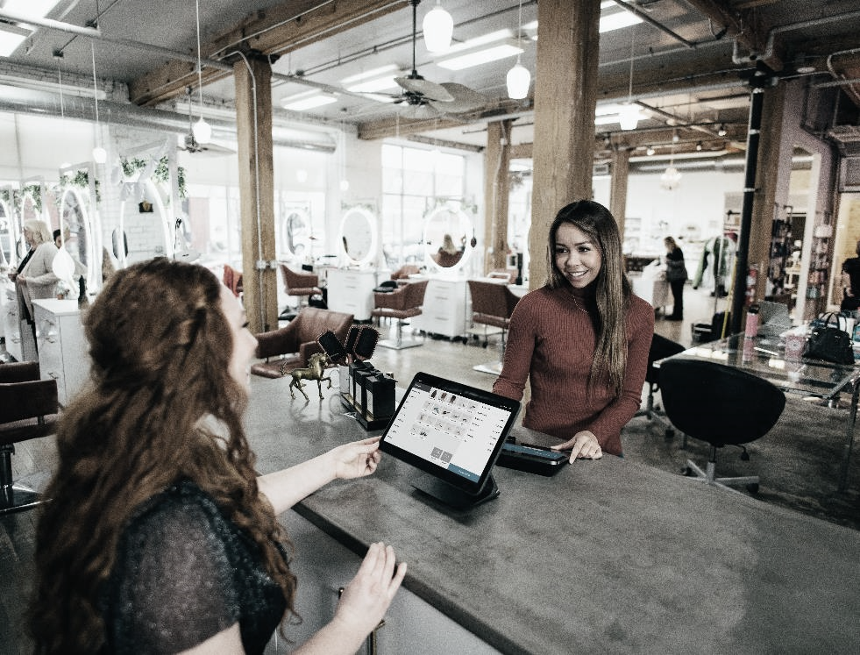

Module 1
Overcoming Socioeconomic Challenges for Successful Migrant Entrepreneurship
www.ingrow-project.eu
This resource is licensed under CCBY 4.0

Slide 2
TABLE OF CONTENTS
01
Socio-economic challenges for migrant entrepreneurs
02
Cultural adaptation: How to achieve it and stay authentic?
03
Develop effective networking and mentorship strategies
04
Identify opportunities for social and economic inclusion
05
Social and personal economic goals
2

Slide 3

SECTION
01
Socio-economic challenges for migrant entrepreneurs

Slide 4

Immigration and Entrepreneurship
Research shows that the willingness to engage in entrepreneurial activities is higher for immigrants than natives. But, among those who started a new business, immigrants have lower chances than natives to succeed in the subsequent steps of entrepreneurship. Immigrant entrepreneurs might face more barriers than natives in starting and developing a business successfully.¹
1 Munich Personal RePEc Archive Immigration and entrepreneurship in Europe: cross-country evidence Riillo, Cesare Fabio Antonio and Peroni, Chiara STATEC Research, STATEC 12 September 2022

Slide 5

According to the mentioned 2022 research by Riillo and Peroni from STATEC Research, non-EU immigrants in Europe are more interested in starting a businesses than those from within the EU, but they face tough challenges that affect their success. The longer the immigrants stay, the more similar their business behaviour becomes to non-immigrants. Even though non-EU immigrants are keen on starting businesses, they don't succeed as much as their intra-EU peers due to hurdles.
The study shows that the longer immigrants stay, the less likely they are to consider starting a business. Although immigration is good for business, many immigrant entrepreneurs face obstacles, keeping them from reaching their full potential. Overcoming these barriers is vital for unlocking economic benefits, encouraging innovation, and improving immigrant acceptance in Europe.
Research Findings

Slide 6

Navigating the Challenges
Empowering migrants to overcome barriers fosters economic growth and shared prosperity. Successful navigation not only benefits individual entrepreneurs but also enriches society by embracing diversity and promoting inclusivity.
Diversity is the engine of invention. It generates creativity that enriches the world.
Justin Trudeau, Prime Minister of Canada

Slide 7

What are the socio-economic challenges for migrant entrepreneurs?
List of challenges
Cultural barriers
Access to financial resources
Legal and regulatory challenges
Discrimination and prejudice
Limited social networks
Educational and skills gap
Access to market information
Healthcare and social services
Housing and cost of living
Family and social integration
Technology and infrastructure
7
7

Slide 8

What are the socio-economic challenges for migrant entrepreneurs?
What do policies say?
The EU Framework on Integration aims to promote the social and economic inclusion of third-country nationals.
Programmes like the European Structural and Investment Funds (ESIF) may include support for entrepreneurship, particularly for marginalised groups.
The Racial Equality Directive and the Employment Equality Directive are legal instruments aimed at combating discrimination on grounds of racial or ethnic origin.
8
8

Slide 9

What are the socio-economic challenges for migrant entrepreneurs?
What do policies say?
The European Agenda for Adult Learning and the New Skills Agenda for Europe aim to enhance the skills of the European workforce, including migrants.
The EU supports research and data collection through programmes like Horizon 2020, which informs policymaking, including initiatives related to migration and entrepreneurship.
The European Migration Network (EMN) facilitates information exchange and cooperation between EU member states on migration-related issues. Coordination mechanisms exist to ensure a coherent approach to migration and integration.
9
9

Slide 10




Self-reflection exercise: Identifying personal socio-economic challenges
What is needed?
Poster board, magazines, markers, paper
Aim
Aids in visualising goals, tracking milestones, and strategising your journey
Output
A visual and practical tool that provides a clear snapshot and serves as a tangible roadmap for self-reflection, helping you track progress, identify areas for improvement, and strategically navigate the socio-economic challenges
Instructions
Vision Board: Collect images representing your goals, arrange on a board.
Pathway Timeline: Draw a timeline, mark milestones and reflect on progress.
Resource Inventory: List skills, knowledge, and support networks.
Stress Zones & Coping: Map stress areas, outline coping strategies.
Language Tree: Draw a tree for communication aspects, address language barriers.

Slide 11
Examples of socio-economic challenges
Pressure to survive and succeed: Migrants may face daily struggles to cover living expenses, secure stable employment, and establish financial stability.
Stereotyping and stigmatisation: Imagine navigating an environment where societal expectations and prejudices act as barriers to success - it's like trying to fit into a puzzle where some pieces don't seem to click.
Socio-spatial and socio-economic exclusion: This includes feeling left out geographically and economically. The struggle involves wanting inclusion in both social and economic spheres.
Acceptance by local entrepreneurs’ type: Fitting in with local entrepreneurs is a big deal. It's not just about having the skills; it's also about convincing others to see past labels.
11

Slide 12

SECTION
02
Cultural adaptation: How to achieve it and stay authentic?

Slide 13

WHAT IS CULTURAL ADAPTATION?
Cultural adaptation is the adjustment of behaviours, values, and customs to engage with a new culture, fostering understanding and relationships. It involves aligning with host culture norms in lifestyle, communication, and social practices.

Slide 14
What is Cultural Adaptation?
This dynamic process is essential for navigating diverse social landscapes, fostering mutual understanding, and building successful relationships between people from different cultural backgrounds.
Cultural adaptation varies across societies due to the distinct norms, values, and expectations that shape each cultural environment.
Cultural adaptation is not about assimilation but includes the preservation of one's identity while embracing elements of the new culture. It requires flexibility, open-mindedness, and empathy to bridge cultural gaps and promote harmonious coexistence in multicultural settings.
14

Slide 15
CASE STUDY: Cultural Integration Dynamics of Afghan Refugees in Sweden
A research from 2019 analysed how Afghan refugees in Sweden authentically adapt to both Afghan and Swedish cultures. Key strategies, like integration, foster a shared community identity. Factors such as age, education, proximity to the host society, gender, and migration reasons influence adaptation, with younger, educated individuals and women adapting faster. Practical steps include group meetings and learning the Swedish language. Success hinges on genuine participation from the Swedish community, offering support for refugees to authentically adjust. The study suggests shared needs among diverse refugee groups, encouraging a holistic approach to cultural integration. It highlights achieving cultural adaptation while staying true to one's identity, emphasising the collaborative effort between migrants and host societies².
2 Anaraki, A.K. (2017) Cultural Integration: The Case of Afghan Refugees in Sweden Peace and Development Studies. Linnaeus University.
15

Slide 16
THE CULTURAL ADAPTATION CURVE
The cultural adaptation curve illustrates the emotional journey of individuals adjusting to a new culture. This idea shows that getting used to a new culture is not a straightforward process, but rather non-linear and dynamic in nature. It can be tricky and change a lot, pointing out the difficulties and good things that come with adapting to a new culture.

Slide 17
THE CULTURAL ADAPTATION CURVE
POSITIVE EMOTION
Honeymoon Phase
Adaptation Phase
Everything seems new and different;
Excitement, similar to being a visitor;
Motivated to learn;
Lasts long if adaptation is easy.
Frustrations subside, competence in local culture grows;
Created a home, managing daily life, and made new friends;
Well-balanced life
NEUTRAL
NEGATIVE EMOTION
HONEYMOON
FRUSTRATION
ADAPTATION
Frustration Phase
Language and cultural barriers frustrate;
Longing for the familiar
Opinion of new culture dips;
Transition to Local Resident

Slide 18


Culture Shock and The Cultural Adaptation Cycle [What It Is and What to Do About It]
If you would like to learn more about the Cultural Adaptation Curve, check out this VIDEO!

Slide 19

AUTHENTICITY
Balancing adaptation with authenticity requires understanding cultural nuances without losing your identity. Keep an open mind because real cultural adaptation means finding a middle ground between embracing new things and staying true to yourself in a diverse world.

Slide 20
Cultural adaptation activity: Embracing cultural differences while staying true to oneself
Culture Collage: Participants can create collages by using various materials that resonate with their cultural identity. By blending them all together, this hands-on activity promotes a vivid celebration of diversity, fostering a creative and authentic exchange of cultural stories within the group.

Slide 21



Embrace Your Core Values
Hold onto the principles and beliefs that are important to you. Use your core values as a foundation, allowing them to guide your decisions and actions.
Maintain Cultural Identity
Celebrate and engage in activities that reflect your cultural background. Staying connected to your roots helps preserve a sense of identity.
Seek Understanding, Not Assimilation
Strive to understand the new culture rather than completely assimilate. Incorporate aspects that align with your values, while preserving your authentic self.
21

Slide 22

SECTION
03
Develop effective networking and mentorship strategies

Slide 23
About networking as a migrant/minority founder
Networking as a migrant or minority founder involves overcoming cultural barriers, building connections in a new environment, and navigating unique challenges to establish a supportive professional network.
23

Slide 24
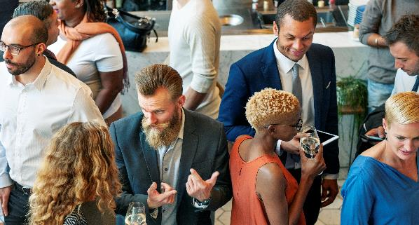
Possible sources of networking
Unlocking opportunities via these concrete sources for networking that facilitate connections, collaboration and support in navigating the entrepreneurial landscape can help ease the entrepreneurial journey.
Local Chamber of Commerce
Minority Business Networking Events
Specific LinkedIn and Industry Forums
Mentorship Programmes for Minority Entrepreneurs
Community-Based Entrepreneurship Workshops
Government Small Business Initiatives
Diverse Co-Working Spaces

Slide 25


CASE STUDY: EKE group
EKE (Entrepreneurship & Knowledge Exchange) group is an initiative created by Outside Media & Knowledge, with the desire to create a space for sharing knowledge in the area of entrepreneurship, non-formal adult education, and empowerment through professional and personal development of skills and networks.

Slide 26

CASE STUDY: EKE group – each meeting focuses on a different topic or skill

Slide 27
CASE STUDY: EKE group
As a place for kindness, mutual support, learning, and useful information, this group is inclusive and welcomes diverse people, with the aim to enable meaningful exchange of knowledge and resources. They want to see the progress of small and medium-sized entrepreneurs, especially those who struggle because of language, or any other obstacles in the area of Germany.
By mutually sharing meaningful resources related to the topics of entrepreneurship, personal development, and professional growth, this group serves as a great example of networking opportunity for those who find themselves on the outskirts of society. It also creates and encouraging and inspiring environment for those who need motivation in their journey.

Slide 28

IMPORTANCE OF MENTORSHIP
Mentorship is especially crucial as migrants often face unique challenges in unfamiliar business landscapes. Having a mentor provides them with an extra boost by offering guidance, insights, and a support network, helping navigate cultural nuances, access resources, and overcome barriers, ultimately increasing their chances of success.
“
A mentor is someone who allows you to see the hope inside yourself.
Oprah Winfrey
28
28

Slide 29
EXERCISE: Networking and mentorship simulation: Building a support network
In this simulation, participants step into the shoes of migrant entrepreneurs facing the dual challenge of launching a business and navigating a new cultural landscape. The exercise incorporates scenarios reflecting cultural nuances, language barriers, and the unique perspectives.
Through interactive role-playing, participants practice culturally sensitive networking strategies, fostering understanding and collaboration. The simulation encourages participants to embrace their unique experiences while building connections, highlighting the strength in diversity.
By addressing the complexities of being different as a migrant entrepreneur, this exercise aims to equip participants with the skills needed to forge meaningful connections, promote inclusivity, and thrive in the multicultural business environment.

Slide 30
SECTION
04
Identify opportunities for social and economic inclusion

Slide 31
CASE STUDY: INTEGREAT
Integreat, a digital integration platform, stands at the forefront of identifying opportunities for social and economic inclusion for migrants in Germany. Embraced by over 100 municipalities, it revolutionises information access for newcomers with its multilingual interface, offering localised insights and simplifying intricate processes.

Slide 32
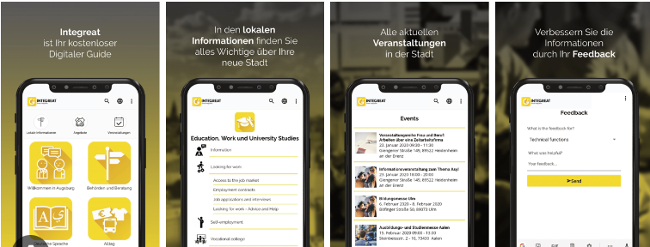
CASE STUDY: INTEGREAT (www.integreat.app)
The app not only facilitates smoother integration but also serves as a crucial tool for migrants to access local services and economic opportunities.
With an adaptable and inclusive design, Integreat empowers migrants to navigate complex landscapes, offering insights into local services and economic pathways.
The impact is reflected in over 3 million annual users, with successful implementations in over 60 cities, showcasing its prowess in supporting migrants on their integration journey.
Through digital literacy initiatives and inclusive content creation, it actively contributes to the identification and realisation of social and economic opportunities, marking a milestone in technology-driven solutions for inclusive integration work.

Slide 33
Analyse local economic and social eco-system – spot opportunities
To identify these opportunities in the entrepreneurial journey of migrants, a critical first step is analysing the local economic and social ecosystem. This involves a thorough examination of community needs, existing business networks, and support structures.
Identifying gaps in services or products, understanding local consumer behaviors, and pinpointing areas where migrant entrepreneurs can contribute adds value.
By recognising and capitalising on the unique opportunities within the local ecosystem, migrant entrepreneurs can forge connections, foster community engagement, and contribute meaningfully to both social and economic prosperity.
33

Slide 34
SECTION
05
Social and personal economic goals

Slide 35
How can better social-economic situation for migrants result in better ideas and more opportunities for business?
Elevating migrants' socio-economic status fosters an environment for innovative ideas and expanded business opportunities. Their diverse perspectives, experiences, and skills enrich the entrepreneurial landscape.
Fostering inclusivity unlocks a broader range of creative solutions, contributing to novel ideas and entrepreneurial ambitions.
Empowering migrants not only enriches the cultural and economic fabric but also propels societies forward by embracing the innovation arising from a more inclusive and economically empowered population.
35

Slide 36

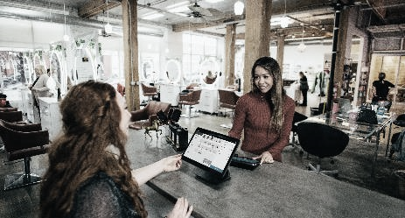


Aligning social and personal economic goals in the entrepreneurial journey of migrants not only cultivates financial stability but also fosters a sense of community engagement, creating a holistic framework for long-term success.
RECIPE FOR SUCCESS
36
36

Slide 37
Exercise: Setting and achieving social goals via calendar of local and regional events
What is needed?
A calendar, whether digital or physical, and writing materials.
Aim
Encourage setting and achieving social goals by actively engaging with local and regional events
Output
Participants will have a personalised calendar outlining upcoming events and strategies to achieve their social goals
Instructions
Compile a list of local and regional events that align with personal interests, community involvement, or professional networking. Include dates, times, and locations.
Next, define specific social goals and establish achievable targets within a given timeframe.
Develop strategies for actively participating in the selected events to meet your social goals. Consider networking approaches, communication techniques, or personal development activities.

Slide 38
Setting and achieving personal economic goals, as a precondition for business
Attaining personal economic goals is vital for migrants venturing into business, paving the way for entrepreneurial success. As financial stability is established, resources for business investment, education, skills development, and capital become available. Meeting economic milestones instills confidence, enabling navigation of entrepreneurial challenges. Achieving personal economic goals provides a solid foundation, empowering calculated risks and opportunities.
This empowerment enhances not only their economic well-being but also their ability to contribute meaningfully to the broader business landscape, fostering an inclusive and dynamic entrepreneurial ecosystem.

Slide 39
Test your understanding of Overcoming Socioeconomic Challenges for Successful Migrant Entrepreneurship
with our exercise!
QUIZ TIME!
39
39

Slide 40

www.ingrow.eu
Follow our journey

